Slide 1

CLASS 6 CD-404 Applications of Data Science in various fields UNIT I
Applications of Data Science in various fields
Prof. Vineeta Shrivastava
Assistant Professor
Department of Computer Science & Engineering
LNCT-E, Bhopal
Lakshmi Narain College of Technology Excellence, Bhopal

Slide 2
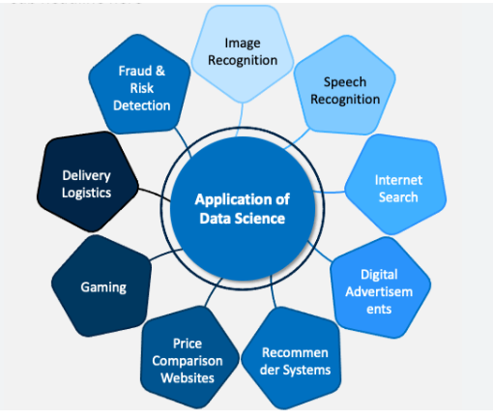
CLASS 6 CD-404 Applications of Data Science in various fields UNIT I
AGENDA
Applications of Data Science in various fields
Prof. Vineeta Shrivastava
Assistant Professor
Department of Computer Science & Engineering
LNCT-E, Bhopal
Lakshmi Narain College of Technology Excellence, Bhopal

Slide 3
CLASS 6 CD-404 Applications of Data Science in various fields UNIT I
Data science has a wide range of applications across various fields, helping organizations make informed decisions, optimize processes, and gain valuable insights.
Healthcare
Predictive analytics for patient outcomes.
Disease diagnosis and early detection.
Drug discovery and development.
Personalized medicine based on patient data.
Prof. Vineeta Shrivastava
Assistant Professor
Department of Computer Science & Engineering
LNCT-E, Bhopal
Lakshmi Narain College of Technology Excellence, Bhopal

Slide 4
CLASS 6 CD-404 Applications of Data Science in various fields UNIT I
Finance
Fraud detection and prevention.
Credit scoring and risk assessment.
Algorithmic trading and financial modeling.
Customer segmentation for targeted marketing.
Prof. Vineeta Shrivastava
Assistant Professor
Department of Computer Science & Engineering
LNCT-E, Bhopal
Lakshmi Narain College of Technology Excellence, Bhopal

Slide 5
CLASS 6 CD-404 Applications of Data Science in various fields UNIT I
Retail
Demand forecasting and inventory optimization.
Customer segmentation and personalized marketing.
Price optimization and dynamic pricing.
Recommender systems for product recommendations.
Prof. Vineeta Shrivastava
Assistant Professor
Department of Computer Science & Engineering
LNCT-E, Bhopal
Lakshmi Narain College of Technology Excellence, Bhopal

Slide 6
CLASS 6 CD-404 Applications of Data Science in various fields UNIT I
Education
Personalized learning platforms.
Predictive analytics for student performance.
Admissions and enrollment optimization.
Educational resource allocation.
Prof. Vineeta Shrivastava
Assistant Professor
Department of Computer Science & Engineering
LNCT-E, Bhopal
Lakshmi Narain College of Technology Excellence, Bhopal

Slide 7
CLASS 6 CD-404 Applications of Data Science in various fields UNIT I
Transportation and Logistics
Route optimization and fleet management.
Demand forecasting for transportation services.
Predictive maintenance for vehicles and equipment.
Supply chain optimization.
Prof. Vineeta Shrivastava
Assistant Professor
Department of Computer Science & Engineering
LNCT-E, Bhopal
Lakshmi Narain College of Technology Excellence, Bhopal

Slide 8
CLASS 6 CD-404 Applications of Data Science in various fields UNIT I
Marketing and Advertising
Customer segmentation and targeting.
Campaign optimization and A/B testing.
Social media analytics.
Customer sentiment analysis.
Prof. Vineeta Shrivastava
Assistant Professor
Department of Computer Science & Engineering
LNCT-E, Bhopal
Lakshmi Narain College of Technology Excellence, Bhopal

Slide 9
CLASS 6 CD-404 Applications of Data Science in various fields UNIT I
Human Resources
Employee performance analytics.
Recruitment and talent acquisition optimization.
Employee satisfaction and engagement analysis.
Workforce planning and optimization.
Prof. Vineeta Shrivastava
Assistant Professor
Department of Computer Science & Engineering
LNCT-E, Bhopal
Lakshmi Narain College of Technology Excellence, Bhopal

Slide 10
CLASS 6 CD-404 Applications of Data Science in various fields UNIT I
Environmental Science
Climate modeling and prediction.
Environmental monitoring and analysis.
Wildlife conservation and biodiversity studies.
Pollution tracking and control.
Prof. Vineeta Shrivastava
Assistant Professor
Department of Computer Science & Engineering
LNCT-E, Bhopal
Lakshmi Narain College of Technology Excellence, Bhopal

Slide 11
CLASS 6 CD-404 Applications of Data Science in various fields UNIT I
THANKYOU
Prof. Vineeta Shrivastava
Assistant Professor
Department of Computer Science & Engineering
LNCT-E, Bhopal
Lakshmi Narain College of Technology Excellence, Bhopal

